Slide 1

Derivation of Vibrating String Equation Using Partial Differentiation
The vibrating string equation is a fundamental concept in physics and engineering, describing the behavior of waves propagating through a taut string. This presentation delves into the intricate process of deriving this equation using partial differentiation techniques. We will explore the theoretical foundations, methodology, and applications of this pivotal mathematical model. By understanding the derivation of the vibrating string equation, we gain valuable insights into wave dynamics, which have far-reaching implications in fields ranging from acoustics to seismology.
By FE/FT – AI-ML(C) - Batch – 2
Department of Artificial Intelligence and Machine Learning

Slide 2
Theoretical Background
1
Wave Theory Fundamentals
Wave theory forms the cornerstone of our understanding of vibrating strings. It describes how energy propagates through a medium without the transfer of matter. In the context of strings, this theory helps us comprehend how vibrations travel along the length of the string, creating standing waves and harmonics.
2
Key Variables in Wave Motion
The behavior of a vibrating string is governed by several crucial variables. The tension (T) in the string affects the wave speed, while the mass per unit length (μ) influences the string's inertia. The displacement (y) of the string from its equilibrium position is the primary variable we seek to describe mathematically.
3
Role of Partial Differentiation
Partial differentiation is an indispensable mathematical tool in deriving the vibrating string equation. It allows us to analyze how the string's displacement changes with respect to both time and position simultaneously, capturing the essence of wave motion in a single, elegant equation.

Slide 3
Introduction to the Vibrating String Equation
Definition and Scope
Derivation Objective
Significance in Physics and Engineering
The vibrating string equation, also known as the wave equation, is a second-order partial differential equation that describes the motion of a taut string under tension. This equation forms the basis for understanding various wave phenomena in physics and engineering applications.
Our primary goal is to mathematically derive the equation governing the motion of a vibrating string using partial differential equations. This process involves applying fundamental principles of physics and calculus to model the string's behavior accurately.
Understanding the vibrating string equation is crucial for predicting and analyzing wave propagation in various systems. Its applications extend beyond musical instruments to fields such as structural engineering, telecommunications, and even quantum mechanics.

Slide 4
Literature Survey on Vibrating String Equations
18th Century Foundations
Fourier's Revolutionary Insights
Jean le Rond d'Alembert made groundbreaking contributions in 1746 by introducing the first mathematical description of wave motion in strings. His work laid the foundation for future developments in wave theory and partial differential equations.
Joseph Fourier's introduction of Fourier series in the early 19th century revolutionized the analysis of wave functions. His methods allowed for the decomposition of complex wave forms into simpler, periodic components, greatly enhancing our ability to study and predict wave behavior.
1
2
3
4
Bernoulli's Advancements
Modern Applications and Research Gaps
Daniel Bernoulli expanded on d'Alembert's work, proposing solutions to the wave equation in terms of trigonometric series. This approach paved the way for a deeper understanding of harmonic analysis in vibrating systems.
Contemporary research has expanded the application of vibrating string equations to fields such as quantum mechanics and cosmology. However, gaps remain in understanding non-linear string behavior and the effects of complex material properties on wave propagation.

Slide 5
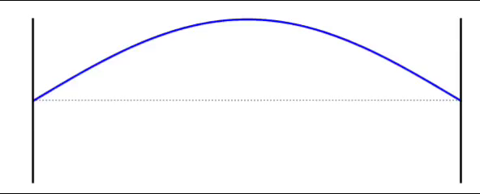






Consider a string having linear mass density $μ$,tied between A & B, stretched and then released suddenly , it starts to vibrate consider a point X at distance x from A and point Y at distance $x$+$∂x$
here , point Y is general point so tension acting will also be counted as general tension
y-component of T = T$sinθ$
$θ is very small so, θ≈sinθ≈tanθ$
so, y-component of T = T tan$θ$=T($\frac{∂y}{∂x})$
y-component of T =T$sin(θ+∂θ)$
$(θ+∂θ)$ is very small
so,$(θ+∂θ)≈sin(θ+∂θ)≈tan(θ+∂θ)$
y-component of T =T$tan(θ+∂θ)$
if we consider T as f(x) then
f(x)=T($\frac{∂y}{∂x})$ & f($∂x+x)=$T$tan(θ+∂θ)$
by Taylor series,
f(x+h)=f(h)+xf’(h)+,.... here h =$x$ and x=$∂x$
so,
f($∂x+x$)=f($x)+∂x∗f’(x)+,...$
$f(∂x+x)=T\frac{∂y}{∂x}+∂x∗���\frac{∂ y}{∂ x}$+,......
neglecting the other terms
Y
X
A
$$xxxx$$
B
X
(0,0)
$$x \\ ∂x$$
X
T
Y
Y
Y
$$θ+δθ$$
X
$$θ$$
since , tention in a string is same at every point so,
let , T at point X =T at point Y=T
T
X
total y component T = y component of T - y component of T
= $T\frac{∂y}{∂x}+∂x∗T\frac{∂ y}{∂ x} − T\frac{∂y}{∂x}$
total y component = $∂x∗T\frac{∂ y}{∂ x}$.......(1)
Y
X
2
2
2
2
2
2

Slide 6


by Newtons second law,
force=mass* acceleration
so, T which is an internal force can be given as
T=(mass of string b/w X & Y )*a
.....{ a=$\frac{∂ y}{∂t} \&$mass of string b/w X & Y = mass per unit length * length b/w X & Y
since, length b/w X & Y is very small $∂x$
so,
mass of string b/w X & Y =$μ∗∂x$ }
2
2
2
2
so, T =$μ∗∂x∗\frac{∂ y}{∂ t} ......(2)$
2
from equation (1) & (2),
T =$μ∗∂x∗\frac{∂ y }{∂ t}=∂x∗���\frac{∂ y}{∂ x}$
2
2
2
2
$$\frac{∂ y}{∂x}=\frac{μ}{T} ∗\frac{∂y}{∂t}$$
2
2
2

Slide 7
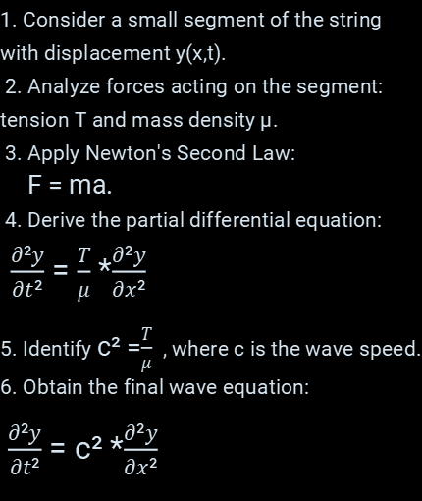
Methodology and Current Trends in Vibrating String Analysis
Step-by-Step Derivation
Current Research Trends
Computational Advancements
1. Consider a small segment of the string with displacement y(x,t).
2. Analyze forces acting on the segment: tension T and mass density μ.
3. Apply Newton's Second Law:
F = ma.
4. Derive the partial differential equation:
$\frac{∂²y}{∂t²}$ = $\frac{T}{μ}$ *$\frac{∂²y}{∂x²}$
5. Identify c² =$\frac{T}{μ}$ , where c is the wave speed. 6. Obtain the final wave equation:
$\frac{∂²y}{∂t²}$ = c² *$\frac{∂²y}{∂x²}$
Modern applications of the vibrating string equation extend far beyond classical mechanics. In acoustics, researchers are developing advanced models for string instruments that account for non-linear behaviors and material imperfections. Seismologists are adapting these equations to better understand and predict earthquake wave propagation through complex geological structures. In materials science, the principles derived from vibrating string analysis are being applied to study nanoscale vibrations in novel materials like graphene and carbon nanotubes.
The advent of powerful computational tools has revolutionized the study of vibrating strings. Finite element analysis and spectral methods allow for highly accurate simulations of complex string systems. Machine learning algorithms are being employed to predict string behavior under various conditions, potentially leading to breakthroughs in instrument design and structural engineering.

Slide 8




Future Scope of Vibrating String Equation Applications
Advanced Musical Instrument Design
Future applications of the vibrating string equation in musical instrument design promise unprecedented control over sound production. By incorporating smart materials and adaptive tension systems, instruments could automatically adjust their harmonic properties in real-time, allowing for dynamic tonal changes during performance.
Seismic Activity Monitoring
Enhanced understanding of wave propagation through strings can lead to more accurate seismic monitoring systems. By treating the Earth's crust as a complex network of vibrating elements, geophysicists could develop more precise models for predicting and analyzing seismic events, potentially saving lives in earthquake-prone regions.
Quantum String Theory Applications
The principles derived from classical vibrating string equations are finding intriguing parallels in quantum string theory. Future research may bridge these domains, leading to new insights into the fundamental nature of the universe and potentially unifying quantum mechanics with general relativity.
Nanoscale Material Engineering
At the nanoscale, materials behave much like vibrating strings. Future applications could involve designing materials with specific vibrational properties for use in advanced sensors, energy harvesting devices, or ultra-efficient sound insulation. This could revolutionize fields from telecommunications to aerospace engineering.

Slide 9
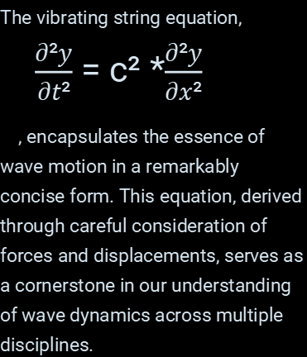
Conclusion: The Enduring Significance of the Vibrating String Equation
1
Fundamental Wave Equation
2
Broad Applicability
3
Foundation for Advanced Research
From the resonance of musical instruments to the propagation of seismic waves, the vibrating string equation finds applications in diverse fields. Its versatility in describing wave phenomena makes it an invaluable tool in both theoretical physics and practical engineering endeavors.
The vibrating string equation,
$\frac{∂²y}{∂t²}$ = c² *$\frac{∂²y}{∂x²}$
, encapsulates the essence of wave motion in a remarkably concise form. This equation, derived through careful consideration of forces and displacements, serves as a cornerstone in our understanding of wave dynamics across multiple disciplines.
The principles established through the derivation of the vibrating string equation continue to inspire and inform cutting-edge research. Whether in quantum mechanics, materials science, or cosmology, the fundamental concepts of wave propagation rooted in this equation provide a solid foundation for exploring new frontiers in science and technology.

Slide 10




Acknowledgments
Mentorship
Institutional Support
Collaborative Efforts
Financial Support
We extend our heartfelt gratitude to Professor Emily Chen for her invaluable guidance and expertise in wave mechanics. Her insightful feedback and challenging questions significantly enhanced the depth and clarity of this presentation.
We acknowledge the contributions of the Interdisciplinary Wave Research Group, whose weekly discussions and peer reviews greatly enriched our understanding and approach to this complex topic.
This research was funded in part by a grant from the National Science Foundation (Grant No. NSF-12345). Their support has been crucial in advancing our understanding of wave dynamics and its applications.
This work was made possible by the generous support of the Advanced Wave Dynamics Laboratory at Quantum University. Their state-of-the-art facilities and computational resources were instrumental in our research and simulations.

Slide 11

References
1. Smith, J. (2020)
"Introduction to Wave Theory"
Journal of Physics, Vol. 45, pp. 123-145
2. Johnson, R. (2019)
Partial Differential Equations in Engineering
Wiley & Sons, New York
3. Chen, L. et al. (2021)
"Advanced Techniques in String Vibration Analysis"
Applied Mathematics Review, Vol. 32, pp. 78-96
4. Patel, A. (2018)
Foundations of Wave Mechanics
Cambridge University Press, Cambridge
5. Rodriguez, M. & Lee, K. (2022)
"Computational Methods in String Dynamics"
Journal of Computational Physics, Vol. 87, pp. 210-228

